Slide 1
Predict Student Performance From Gameplay
https://www.kaggle.com/competitions/predict-student-performance-from-game-play/overview
DATA 3421
Elliott Wooton

Slide 2
Framework
From the Overview page on the Predict Student Performance from Game Play Kaggle competition hosted by The Learning Agency Lab:
“Most game-based learning platforms do not sufficiently make use of knowledge tracing to support individual students… you'll enable game developers to improve educational games and further support the educators who use these games with dashboards and analytic tools.”

Slide 3
Goals
Along with the usual Leaderboard-High Score prizes typically given out with Kaggle challenges, a second leaderboard was created based on a submitted model’s efficiency. The goal is to create the most effective, light weight model that can be used with as little carbon footprint as possible. The efficiency formula is given below, however this formula was not used during this experiment. However, the idea of picking the fastest/most efficient model very much is the focus. The goal of the efficiency formula is to minimize it.

Slide 4
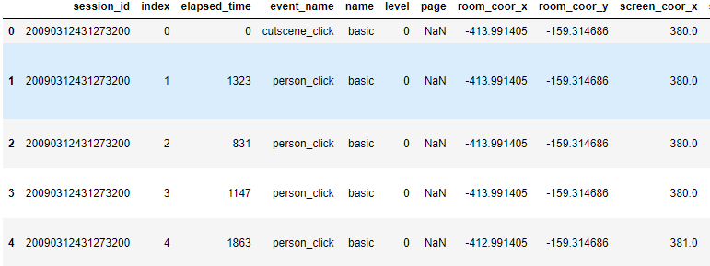
Dataset
4.72 GB Train / 659.86kB Test datasets
Train dataset split into train.csv and train_labels.csv
20 cols / 26.3m rows
Rows are broken up into blocks called sessions, and each session contains every individual event that the player experienced during a given set of levels.
Mix of categorical and quantitative data.

Slide 5
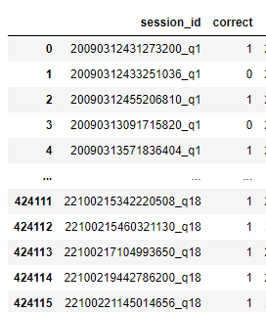
Dataset cont.
Sessions are taken from level groups (“0-4”, “5-12”, “13-22”), with corresponding question pools (“1-3”, ”4-13”, “14-18”).
train_labels.csv lists every question answered individually from 1-18 per session.

Slide 6
Dataset Preprocessing Goals
Dataset is large (4.72GB), so data has to be read and manipulated in chunks.
Aggregate sessions to be able to map train_labels to train’s level_groups.
Feature engineer using pandas groupby DataFrame method to handle both qualitative and quantitative variable types.
Scale / normalize data for potential PCA done in chunks defined by level_group to avoid outlying data.
Construct 3 datasets:
Z-scaled dataset with PCA for MultiC
Z-scaled dataset with VIF for MultiC
Min-max scaled dataset with MultiC unaccounted for

Slide 7
Feature Engineering
From 20 cols that included the level group and session id, 31 cols are created using pandas aggregate “groupby” method for DataFrames.
In the projects “processpipline.py” and its respective class, the mangled method __feature_engineer separates the events into categorical, numerical, and events categories.
Categorical variables are summed by the number of time unique categories appear across a level_group / session to create a new variable
Numerical values have their mean and standard deviations taken to create two new variables
Event categories, as well as the elapsed_time variables are summed to create new variables.

Slide 8
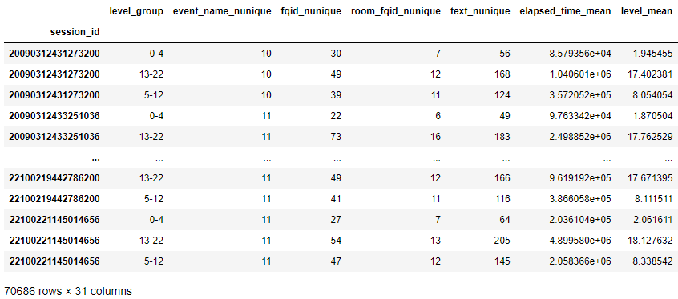
Feature Engineering cont.
With this new dataset, every row represents one level_group per session. With this, models trained for questions that belong to specific level_groups can be trained using their proper, associated data.

Slide 9
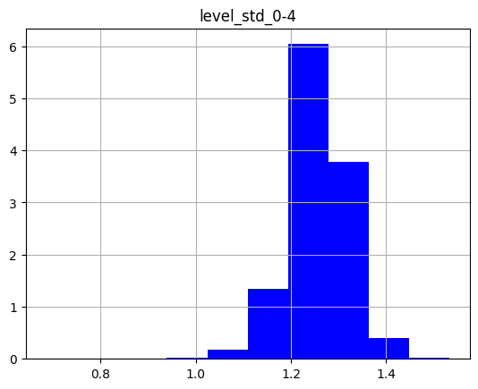
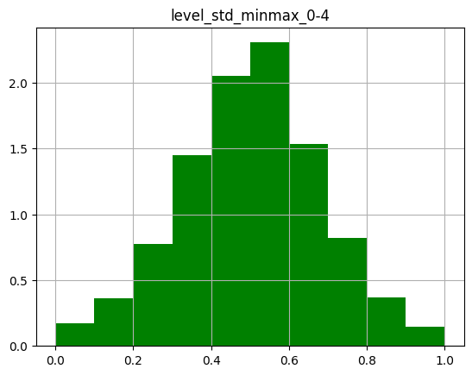
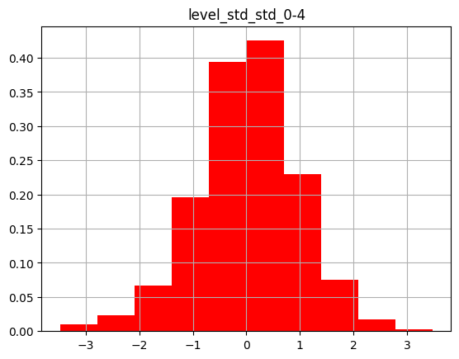
Visualizations
No scaling Histogram for level_std in the 0-4 level_group
min-max scaling Histogram for level_std in the 0-4 level_group
Z-score scaling Histogram for level_std in the 0-4 level_group

Slide 10
Visualizations Cont.
Outliers are removed using the standard methods for Min-Max and Z-score BEFORE previous visualizations.
Min-Max: outliers are removed at the Q25 - 1.5*IQR and Q75 + 1.5IQR range.
Z-score: Removed outside [-3.5,3.5] range.

Slide 11
Finalized Train Set Creation
Multicollinearity is initially tested for by analyzing the correlation matrices of the each level_group category.
Multicollinearity is clearly seen, as is to be expected considering the size of the dataset and method of feature engineering.
At this point, it is decided to go with three datasets: two Z-scaled datasets with different methods of tackling the MultiC problem, and one min-max scaled set with MultiC not accounted for.

Slide 12
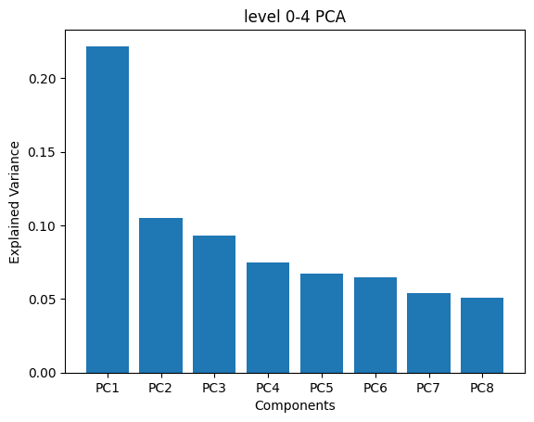
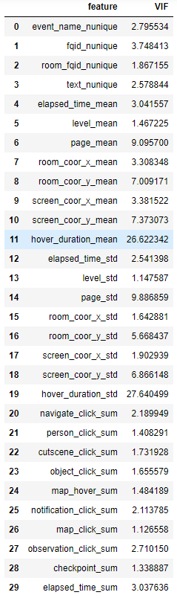
Multicollinearity
The methods of removing Multicollinearity from the Z-scaled:
PCA: Done for each level_group so as not to scale any particular one more based on irrelevant data. Mean variance explained is .73 between the 3 groups, with each containing 8 components.
VIF analysis done for each level_group with different thresholds depending on the VIFs attained. A total of 7 of the same variables were taken from each of the sets, leaving 23 explanatory variables.

Slide 13
Models
Each of three created training sets are fed to 3 models:
Logistic Regression
XGBoost
Random Forest
With cross validation done via GroupKFold with 5 splits and the metric being F1 macro-averaged (unweighted mean) across all the question-based models.

Slide 14
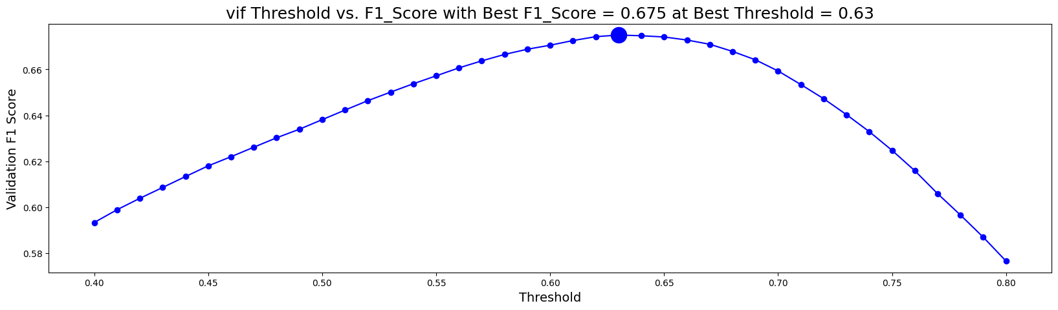

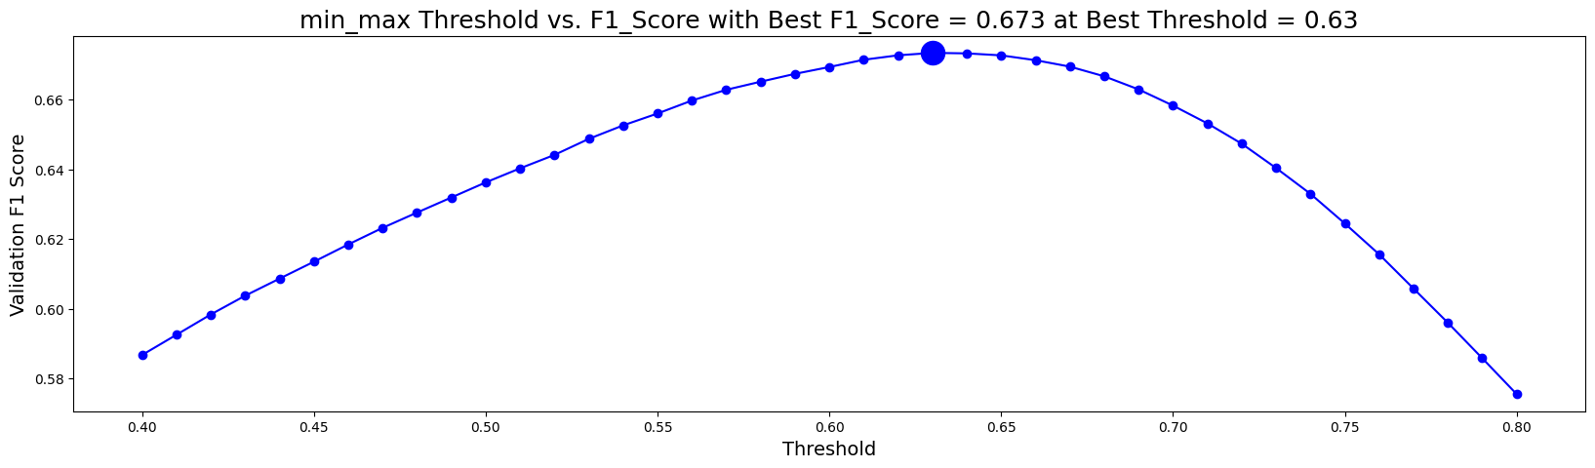
Logistic Regression
Hyper Params:
Maximum Iterations: 200
Solver: Limited Memory BFGS
Penalty: l2
Warm start: True
Time to execute per set:
VIF: 11.7s
PCA: 7.4s
min_max : 19s

Slide 15
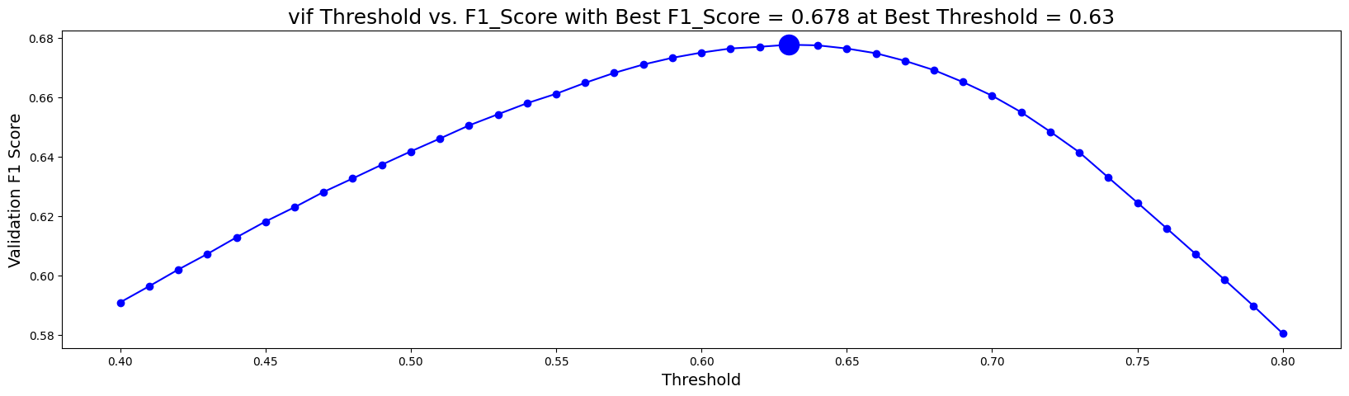
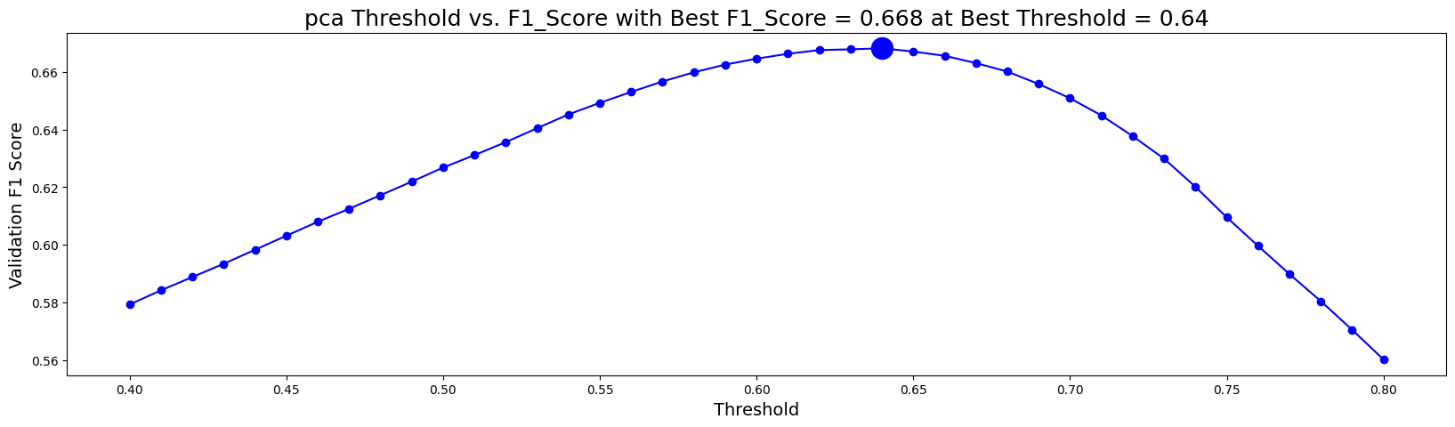
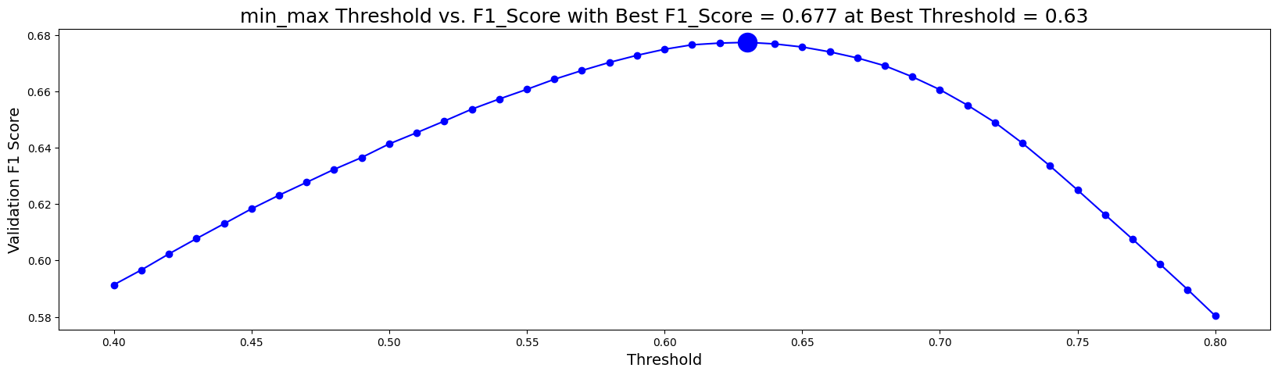
XGBoost
Hyper Params:
objective: binary logistic
eval: logloss
learning rate: 0.05
max depth: 4
estimators: 1000
tree method: hist
early stopping: 50
Time to execute per set:
VIF: 46.6s
PCA: 32.2s
min_max: 54s

Slide 16
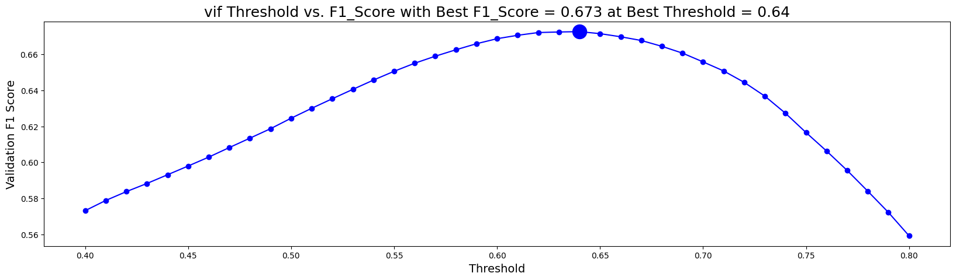
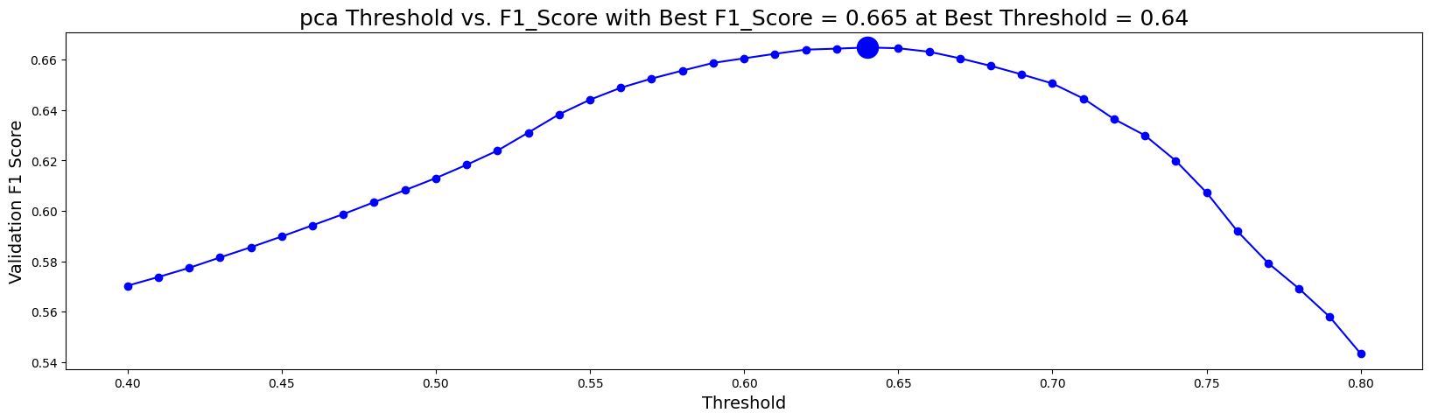
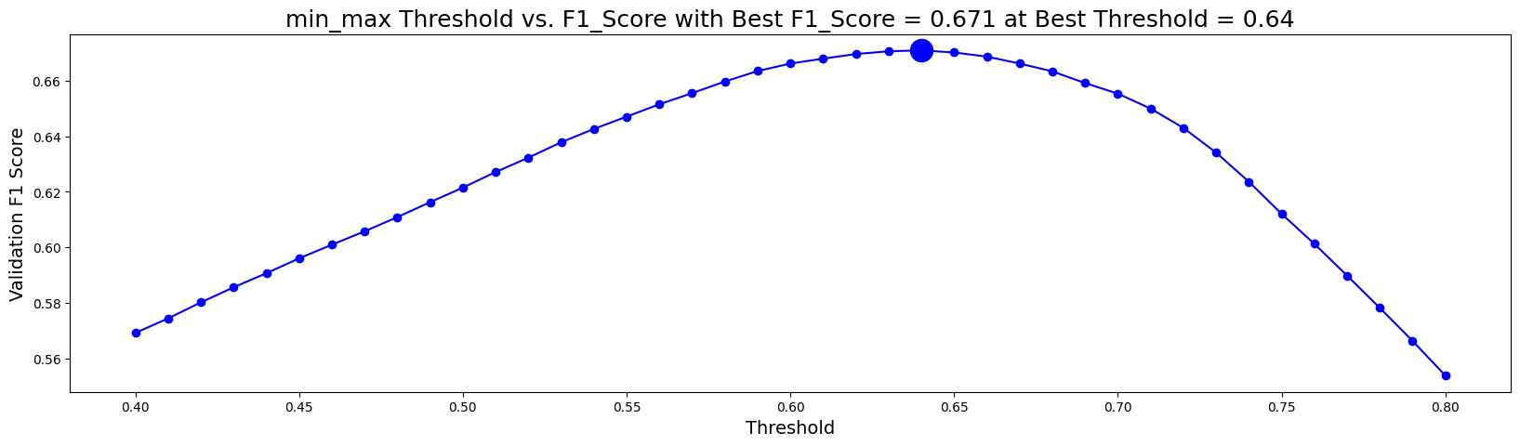
Random Forest
Hyper Params:
criterion: gini index
max features: log2
bootstrap: False
max depth: 4
warm start: True
estimators: 100
Time to execute per set:
VIF: 3min 5s
PCA: 3min 49s
min_max: 3min 6s

Slide 17
Findings and Conclusion
Due to what is most likely a poor choice of algorithms, Almost every single set of 18 models produced similar results. Considering the initial goal of the challenge being finding a lightweight model for educators to be able to use in an analysis tool or on the dashboard of a game-based learning service, Logistic Regression is a clear in winner in terms of time saving. A normalized data using the Z-scale with features removed using VIF has the best F1 score of 0.675 at 0.63 threshold takes about 12 seconds to train the model.

Slide 18
Challenges
Read the data in chunks avoiding memory error
Feature engineering given how the data was arranged
Creating a dictionary of models, one for each question

Slide 19
Future
Ways to improve evaluation metric
Further feature engineering and selection
Consider more models/hyper parameters

Slide 20
References
https://www.kaggle.com/competitions/predict-student-performance-from-game-play/overview
https://www.kaggle.com/code/cdeotte/xgboost-baseline-0-680
https://xgboost.readthedocs.io/en/stable/python/index.html
https://scikit-learn.org/stable/

